Slide 1
A Residual-Based Hybrid Approach for ASELSAN Stock Price Forecasting
Yusuf Emre BAYSAL

Slide 2
Contents
Goal
Theoretical Background
ARMA
ARIMA
Random Forest
GBM
Hybrid Approach: Residuals Method
Methodology
Dataset
Data Preprocessing
AIC
Parameter Optimization
Model Traing
MSE
Simulation Results
ARMA
ARIMA
Random Forest
GBM
Hybrit: ARMA + RF
Hybrit: ARMA + GBM
Hybrit: ARIMA + RF
Hybrit: ARIMA + GBM
Conclusion and Further Work

Slide 3
Goal

Slide 4
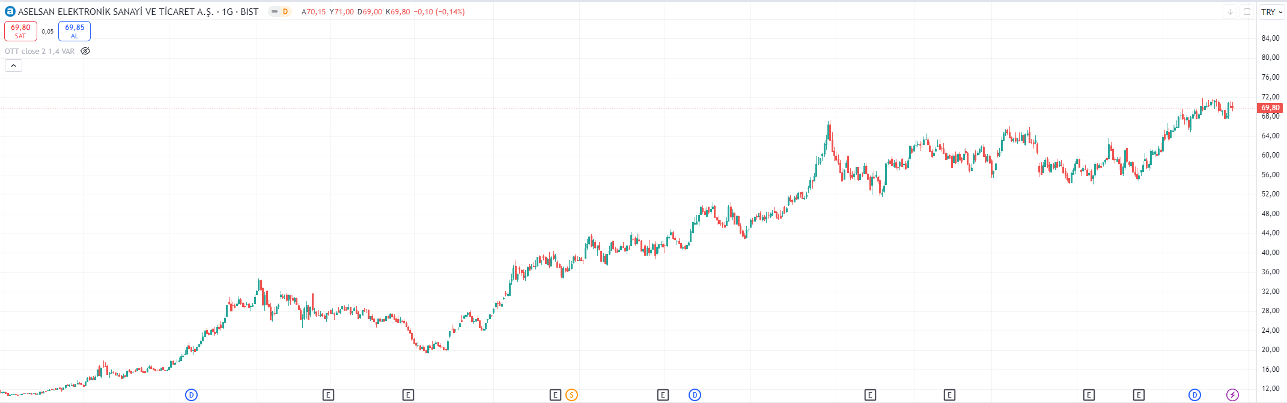
ARIMA Model
Stock prediction by combining the statistical models and machinle learning models.
Notes:
Goal: Time Series Analysis, like any stock price.

Slide 5
Theoretıcal Background

Slide 6
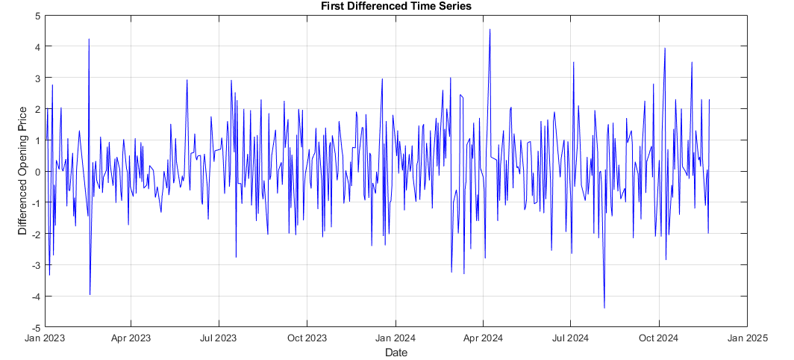
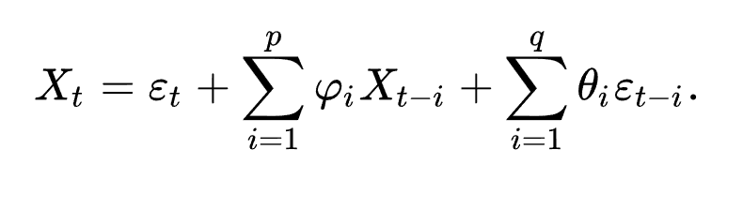
ARMA Model
ARMA (AutoRegressive Moving Average) is a statistical model that combines autoregressive and moving average components to analyze and forecast stationary time series data.
Notes:
Stationary data needed
Where:
XtX_tXt​: The current value of the time series
ccc: A constant term
ϕi\phi_iϕi​: Coefficients for the autoregressive (AR) terms
θj\theta_jθj​: Coefficients for the moving average (MA) terms
εt\varepsilon_tεt​: The error term (white noise) at time ttt
ppp: The number of AR terms
qqq: The number of MA terms

Slide 7
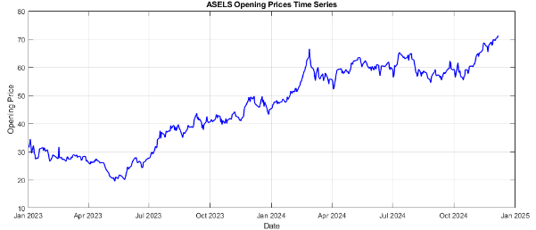
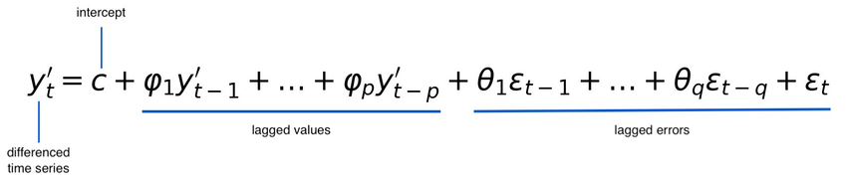
ARIMA Model
ARIMA (AutoRegressive Integrated Moving Average) is a statistical model that extends ARMA by incorporating differencing to make non-stationary time series data stationary, enabling trend and seasonality modeling.
Notes:
Stationary data does not needed
Where:
XtX_tXt​: The current value of the time series
Δd\Delta^dΔd: The differencing operator applied ddd times to achieve stationarity (ΔXt=Xt−Xt−1\Delta X_t = X_t - X_{t-1}ΔXt​=Xt​−Xt−1​)
ccc: A constant term
ϕi\phi_iϕi​: Coefficients for the autoregressive (AR) terms
θj\theta_jθj​: Coefficients for the moving average (MA) terms
εt\varepsilon_tεt​: The error term (white noise) at time ttt
ppp: The number of AR terms
ddd: The degree of differencing
qqq: The number of MA terms

Slide 8
ARMA vs ARIMA Model
ARMA: Modeling a stationary stock return series with no clear trend.
ARIMA: Forecasting a non-stationary stock price series with a trend.
Feature | ARMA | ARIMA
Stationarity | Requires stationary data | Handles non-stationary data
Components | AR + MA | AR + MA + Differencing (I)
Complexity | Simpler, fewer parameters | More complex, additional parameter d
Use Case | Stationary data | Non-stationary data with trends or seasonality

Slide 9
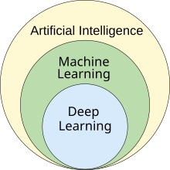
Machine Learning Models
Machine Learning (ML) is a branch of AI where computers learn from data to make predictions or decisions without explicit programming.
Supervised Learning
Unsupervised Learning
Reinforcement Learning

Slide 10

Random Forest Model
Random Forest is a machine learning algorithm that uses a collection of multiple decision trees to improve prediction accuracy and reduce overfitting.
Random Forest reduces overfitting by averaging predictions from multiple decision trees, making it highly robust for datasets with noise and variability.
Supervised Learning

Slide 11
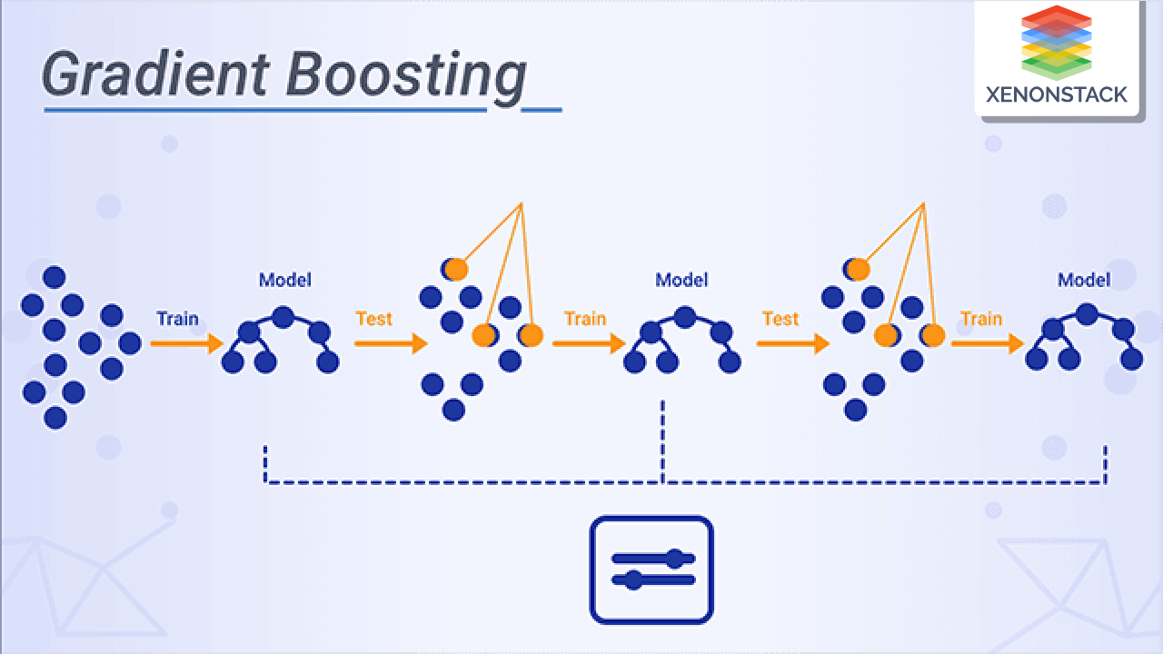
GBM Model
Gradient Boosting Machine (GBM) is a machine learning technique for regression and classification tasks that builds models sequentially. Each new model corrects the errors made by the previous ones by optimizing a loss function.
GBM sequentially improves predictions by focusing on residual errors, resulting in high accuracy even with complex datasets.
Supervised Learning

Slide 12
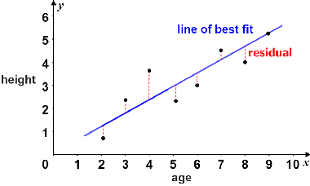
Hybrid Approach: Residuals Method
The Residuals Method works by having the second model focus on the errors (residuals) made by the first model, thus addressing the aspects of the data that the first model could not capture.
Residuals=Actual Values−Statistical Model Predictions

Slide 13
Methodology

Slide 14
Dataset
Aselsan's daily opening stock prices from January 2, 2023, to December 6, 2024 were obtained from Investing.com.
The dataset was divided into training and testing sets, with the last 10 days reserved as the test set to evaluate the models' predictive performance.
Date Opening
___________ _______
25-Nov-2024 68.7
26-Nov-2024 69.05
27-Nov-2024 67.7
28-Nov-2024 68.4
29-Nov-2024 69.9
02-Dec-2024 69.45
03-Dec-2024 70.2
04-Dec-2024 70.45
05-Dec-2024 70.35
06-Dec-2024 71.3
Date Opening
___________ _______
02-Jan-2023 31.44
03-Jan-2023 32.46
04-Jan-2023 34.48
05-Jan-2023 32.76
06-Jan-2023 29.42

Slide 15
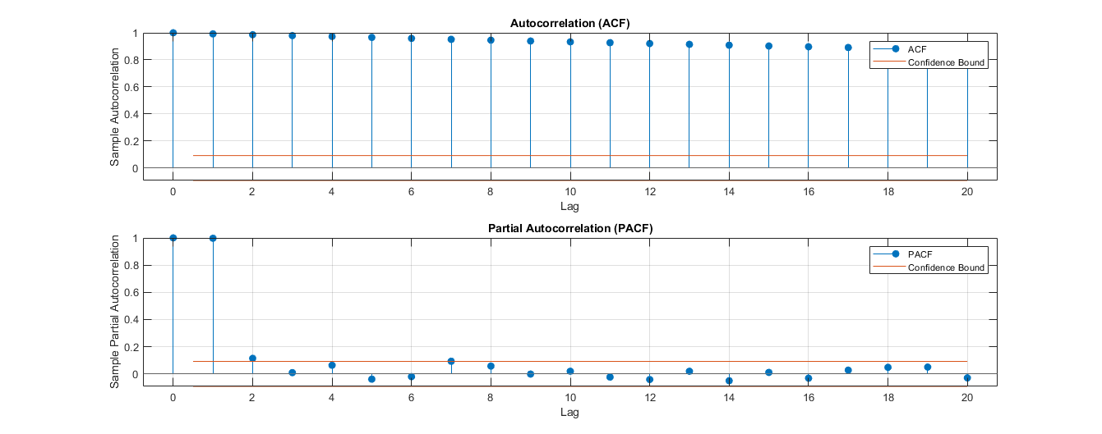
Data Preporcessing
An Augmented Dickey-Fuller (ADF) test was conducted, yielding a p-value of 0.9297, indicating non-stationarity. (For ARMA Model!)

Slide 16
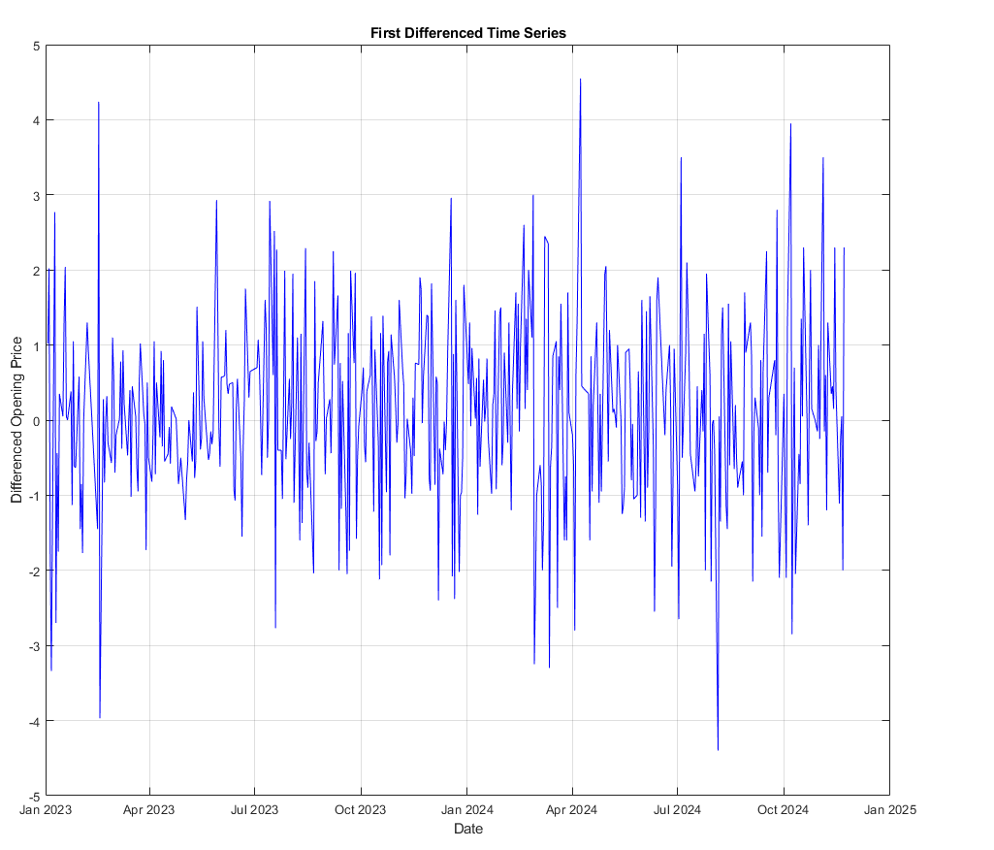
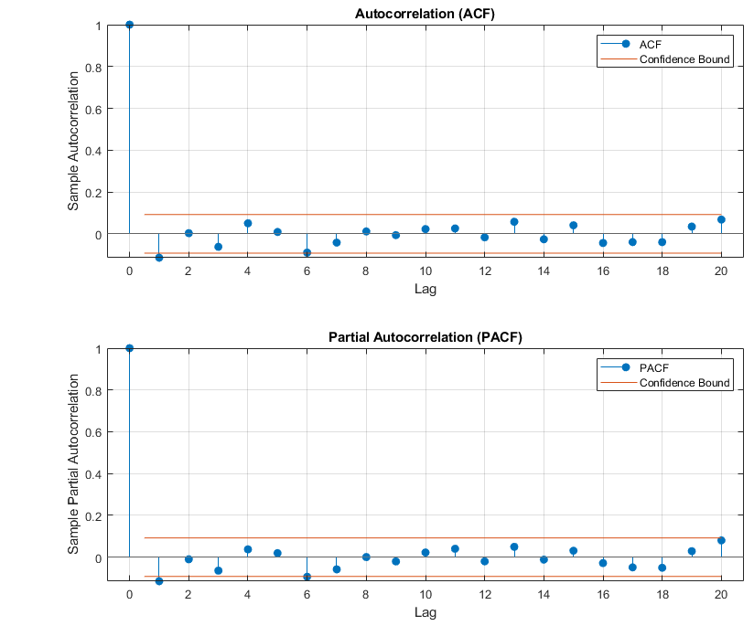
Data Preporcessing
Differencing was applied to achieve stationarity, resulting in a p-value of 0.0010.

Slide 17
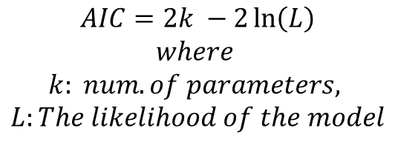
AIC Test
Finding optimal ARMA(p, q) model with detailed output...
p q AIC
0 0 1550.3814
0 1 1546.0266
0 2 1547.9895
0 3 1548.3523
0 4 1549.4046
0 5 1551.3444
1 0 1546.1376
1 1 1547.8114
1 2 1549.3306
1 3 1549.7822
1 4 1551.3913
1 5 1551.3873
2 0 1548.0864
2 1 1549.2434
2 2 1550.2903
2 3 1539.4187
2 4 1541.2898
2 5 1542.9610
3 0 1548.1318
3 1 1549.7802
3 2 1539.2710
3 3 1541.2662
3 4 1543.2661
3 5 1544.9442
4 0 1549.4275
4 1 1551.4204
4 2 1543.6260
4 3 1537.6911
4 4 1536.8262
4 5 1541.2554
5 0 1551.2347
5 1 1552.5168
5 2 1542.8621
5 3 1539.6849
5 4 1534.8548
5 5 1536.8052
Optimal ARMA model: p = 5, q = 4, AIC = 1534.8548
AIC (Akaike Information Criterion) is a measure used to evaluate and compare statistical models, helping to select the best-fitting model while balancing accuracy and complexity. It penalizes models with more parameters to avoid overfitting. Limit was 5 in the simulations.
BIC (Bayesian Information Criterion) is another criterion for selecting the best-fitting model, which was not used in the project.
$$AIC=2k −2\ln\left(L\right)$$
$$where$$
$$k: num. of parameters,$$
$$L:The likelihood of the model$$

Slide 18
Parameter Optimization for ML Models
For Random Forest and GBM, hyperparameters such as window size, tree depth, and the number of boosting rounds were optimized using a trial-and-error approach to achieve the best performance.
Window Size: The subset of data points or features used at a time for training the model, often crucial for time series forecasting.
Number of Trees: The total count of decision trees built in the Random Forest, balancing accuracy and computational cost.
Boosting Rounds: The number of iterations in GBM where each round adds a new tree to correct the errors of the previous ones, improving overall accuracy.

Slide 19
Model Training
For the ARMA model: The data is made stationary, and after performing the AIC test, the model is trained.
For the ARIMA model: The AIC test is conducted directly on the raw values, and the model is trained without making the data stationary.
For Random Forest (RF) and Gradient Boosting Machines (GBM), two different simulations are conducted:
Differenced Values: The data is made stationary, and hyperparameters are tuned to determine the optimal values. The model is then trained on the stationary data.
raw Values: Hyperparameters are tuned to determine the optimal values, and the model is trained directly on the raw (non-stationary) data.

Slide 20
Model Training
For Hybrid Models:
ARMA + RF/GBM: The data is made stationary, the AIC test is performed, and the ARMA model is trained. Residuals are calculated, and the machine learning model (RF or GBM) is trained on these residuals. The final predictions are obtained by combining the results of the ARMA model and the machine learning model.
ARIMA + RF/GBM: The AIC test is conducted, and the ARIMA model is trained directly on the raw data. Residuals are calculated, and the machine learning model (RF or GBM) is trained on these residuals. The final predictions are obtained by combining the results of the ARIMA model and the machine learning model.
For Random Forest, an iterative approach was used, making one-day-ahead predictions and appending them to the dataset for subsequent forecasts. This process was repeated over 10 days

Slide 21
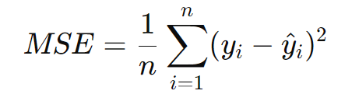
MSE
Mean Squared Error (MSE) is a common metric used to evaluate the accuracy of a predictive model by measuring the average squared difference between the actual values and the predicted values.

Slide 22
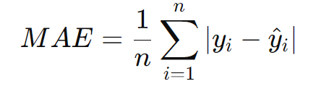
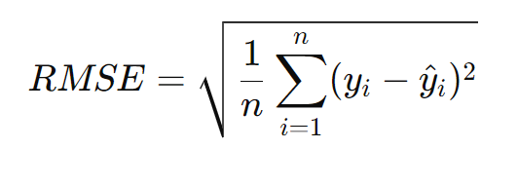
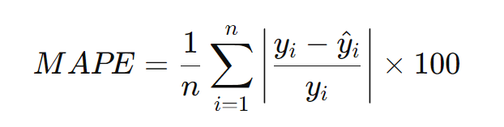
Other Metrics Used Im Simulations
MAE (Mean Absolute Error): The average of absolute differences between actual and predicted values, measuring overall prediction accuracy.
RMSE (Root Mean Squared Error): The square root of MSE, providing error in the same units as the target variable and emphasizing large errors.
MAPE (Mean Absolute Percentage Error): The average of absolute percentage errors, showing prediction accuracy as a percentage.

Slide 23
Sımulatıon results

Slide 24
Simulations
ARMA (differenced values)
ARIMA (raw values)
GBM (differenced values)
GBM (raw values)
Random Forest (differenced values)
Random Forest (raw values)
Hybrid: ARMA + Random Forest (differenced values)
Hybrid: ARMA + GBM (differenced values)
Hybrid: ARIMA + Random Forest (raw values)
Hybrid: ARIMA + GBM (raw values)

Slide 25
5 vs 10 Day Comparison
Model | MSE 5 Days | MSE 10 Days
ARMA (differenced values) | 1.1278 | 2.3722
ARIMA (raw values) | 1.3508 | 3.2725
GBM (differenced values) | 0.6287 | 0.7532
GBM (raw values) | 2.0368 | 4.8891
Random Forest (differenced values) | 0.6039 | 1.0527
Random Forest (raw values) | 5.4862 0.7002* | 10.7804 2.5405*
ARMA + Random Forest (differenced values) | 1.2389 | 3.2398
ARMA + GBM (differenced values) | 2.1520 | 6.1314
ARIMA + Random Forest (raw values) | 1.1095 | 3.5692
ARIMA + GBM (raw values) | 0.9710 | 3.6428
* Offset added results

Slide 26
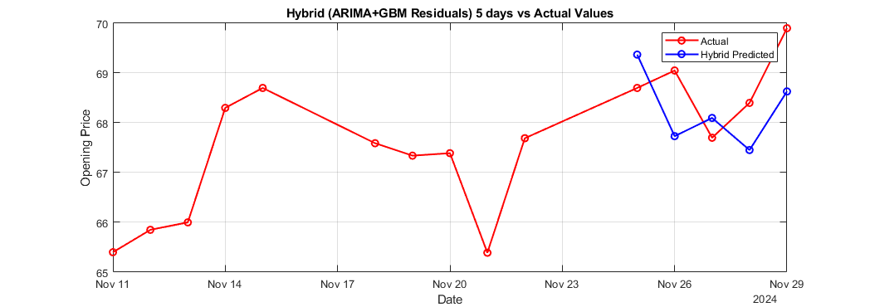
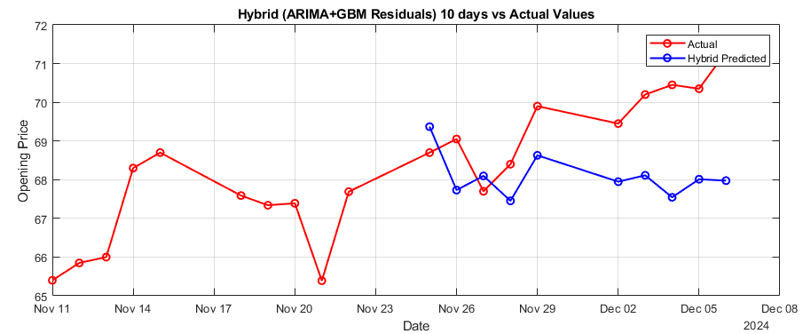
5 vs 10 Day Comparison
Hybrid (Arima + GBM) 5 days Model Prediction
Hybrid (Arima + GBM) 10 days Model Prediction

Slide 27
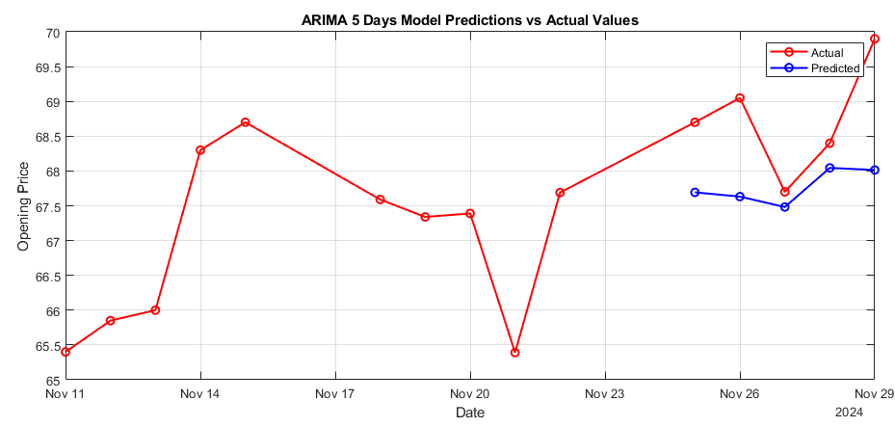
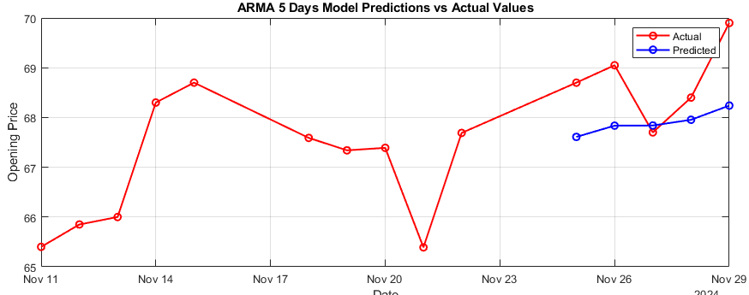
ARMA and ARIMA
ARMA
ARIMA
ARMA(5, 4)
MSE: 1.1278
ARIMA(5, 1, 5)
MSE: 1.3508

Slide 28
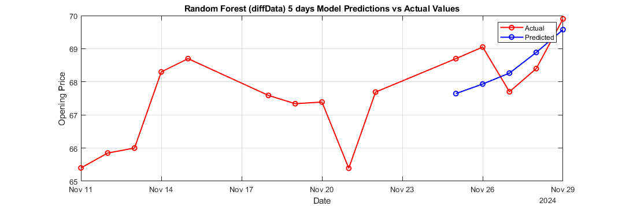
Random Forest – Differenced Values
Window Size: 60
Trees: 50
MSE: 0.6039

Slide 29
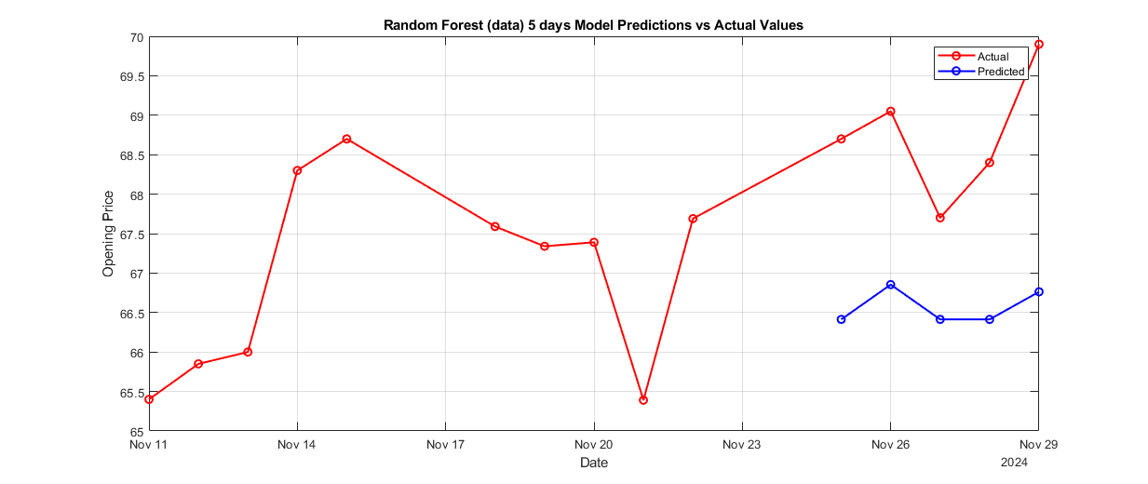
Random Forest – raw Values
Window Size: 45
Trees: 10
MSE: 5.4862

Slide 30
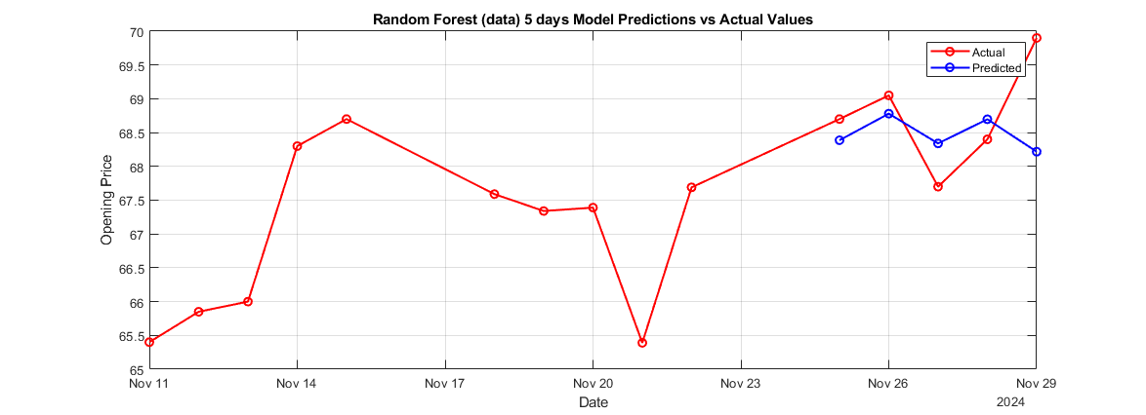
Random Forest – raw Values with Offset
Window Size: 45
Trees: 10
MSE: 0.7002

Slide 31
Random Forest Comparison
Differenced Data
raw Data
raw Data with Offset
Window Size: 60
Trees: 50
MSE: 0.6039
Window Size: 45
Trees: 10
MSE: 5.4862
Window Size: 45
Trees: 10
MSE: 0.7002

Slide 32
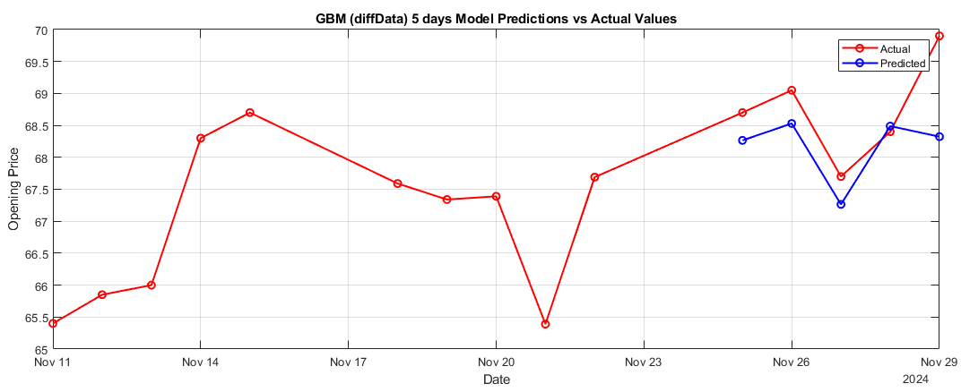
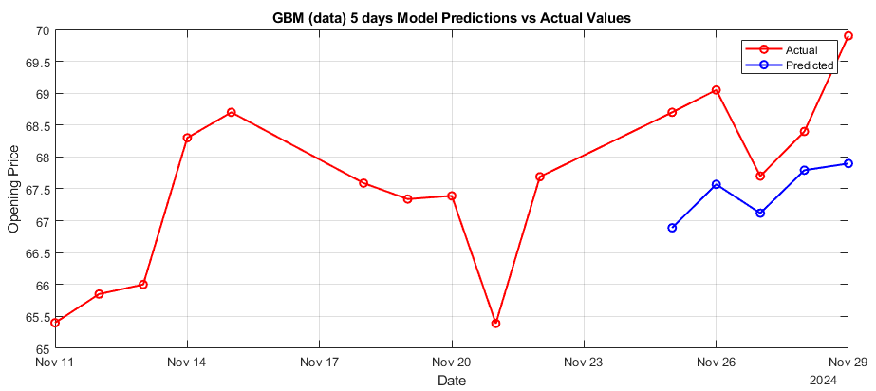
GBM raw vs Differenced Data
Differenced Data
raw Data
Window Size: 15
Boosting Stages: 50
MSE: 0.6287
Window Size: 15
Boosting Stages: 50
MSE: 2.0368

Slide 33
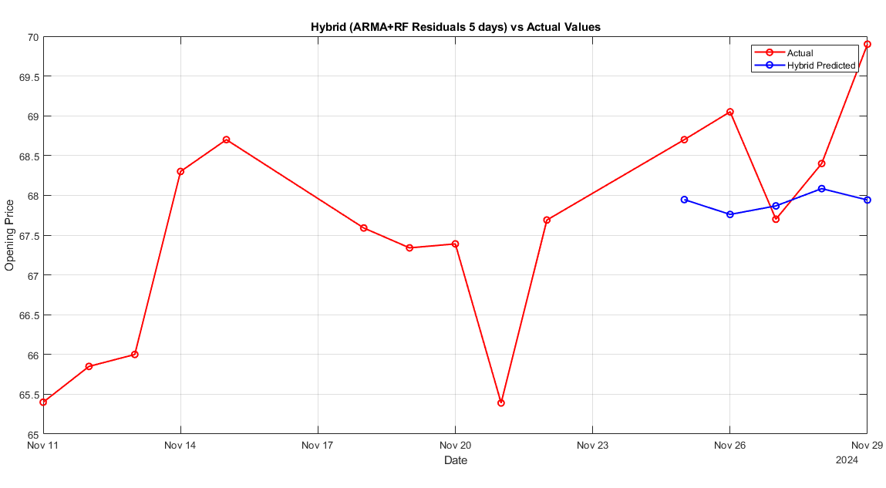
Hybrid: ARMA + Random Forest
ARMA(5, 4)
Window Size: 60
Trees: 100
MSE: 1.2389

Slide 34
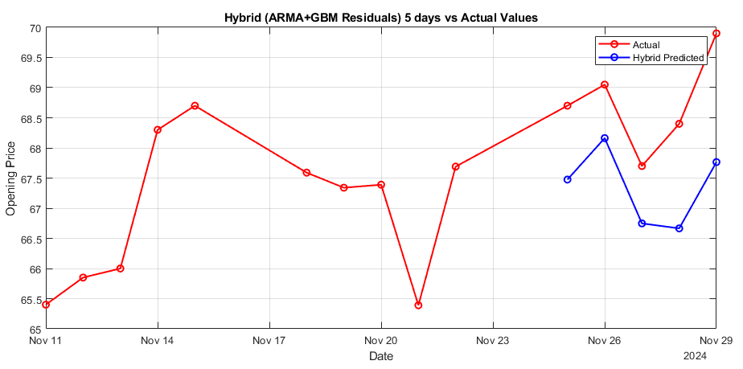
Hybrid: ARMA + GBM
ARMA(5, 4)
Window Size: 200
Trees: 55
MSE: 2.1520

Slide 35
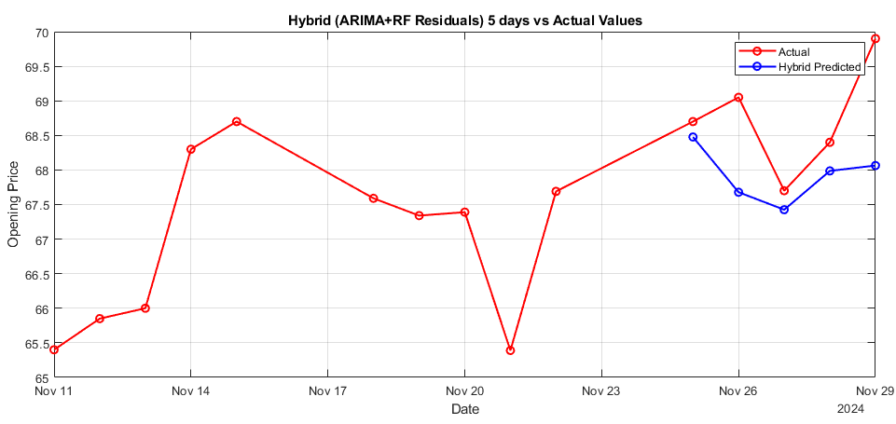
Hybrid: ARIMA + Random Forest
ARIMA(5, 1, 5)
Window Size: 60
Boosting Stages : 100
MSE: 1.1095

Slide 36
Hybrid: ARIMA + GBM
ARIMA(5, 1, 5)
Window Size: 60
Boosting Stages : 100
MSE: 0.9710

Slide 37
Conclusıon and Furthure Work

Slide 38
ARMA vs Hybrid ARIMA
ARMA
ARMA + Random Forest
ARMA + GBM
MSE: 1.1278
MSE: 1.2389
MSE: 2.1520

Slide 39
ARIMA vs Hybrid ARIMA
ARIMA
ARIMA + Random Forest
ARIMA + GBM
MSE: 1.3508
MSE: 1.1095
MSE: 0.9710

Slide 40
Best Results
Random Forest with Differenced Data
GBM with Differenced Data
MSE: 0.6287
MSE: 0.6039
Notes:
Visual inspectation: GBM has better trend following.

Slide 41
Further Work
Future research should use more diverse datasets and include financial indicators like trading volume, MACD, and RSI to improve accuracy.
Exploring deep learning models may provide better performance due to their ability to capture complex, non-linear relationships.
Prediction models should be tailored to specific stocks, focus on short-term forecasts, and be continuously updated with new data.
Despite mixed results with hybrid models, this study demonstrates the potential of machine learning methods like Random Forest and GBM when applied to well-preprocessed data.

Slide 42
Thank You For Lıstenıng
Yusuf Emre Baysal

